Slide 1
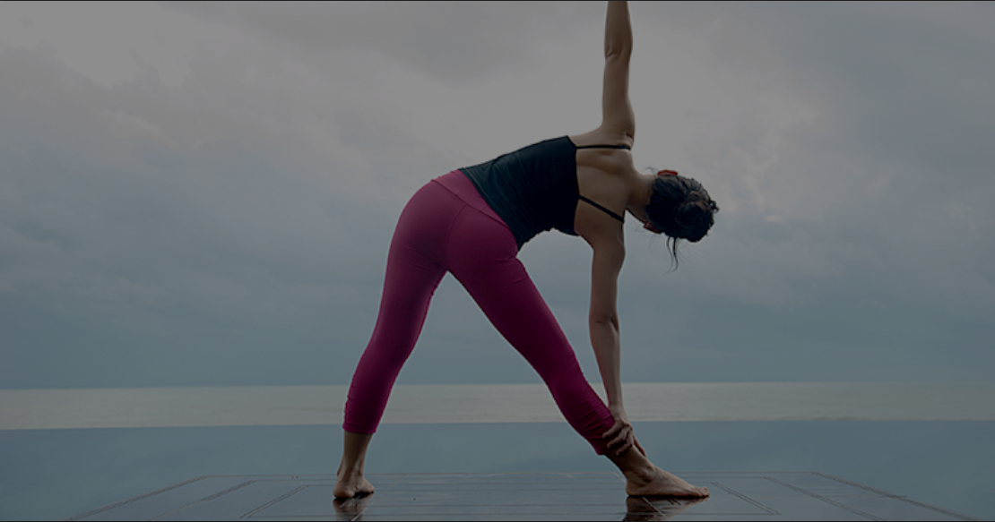
WORKOUT POSE DETECTION
Ankit Kalra, Senior Data Scientist, Fractal Anlaytics
Aakash Goel, Data Scientist, Fractal Analytics

Slide 2
Outline
What, why, Application
Dataset Discussion
Model Training
Model Comparison
Result
Challenges and Future Scope

Slide 3
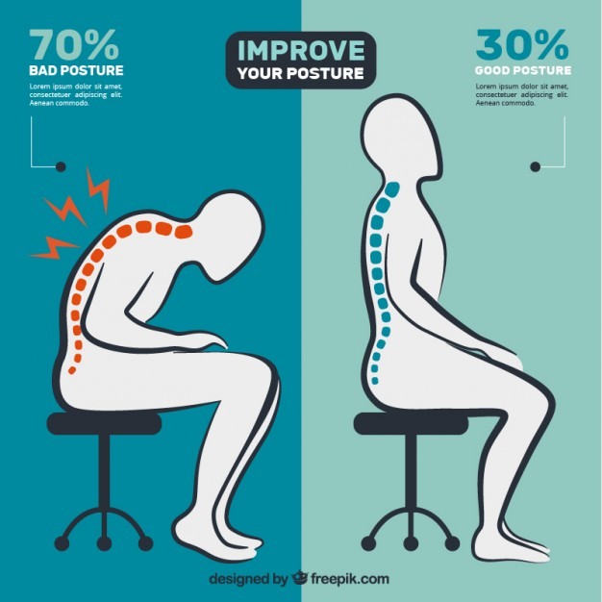
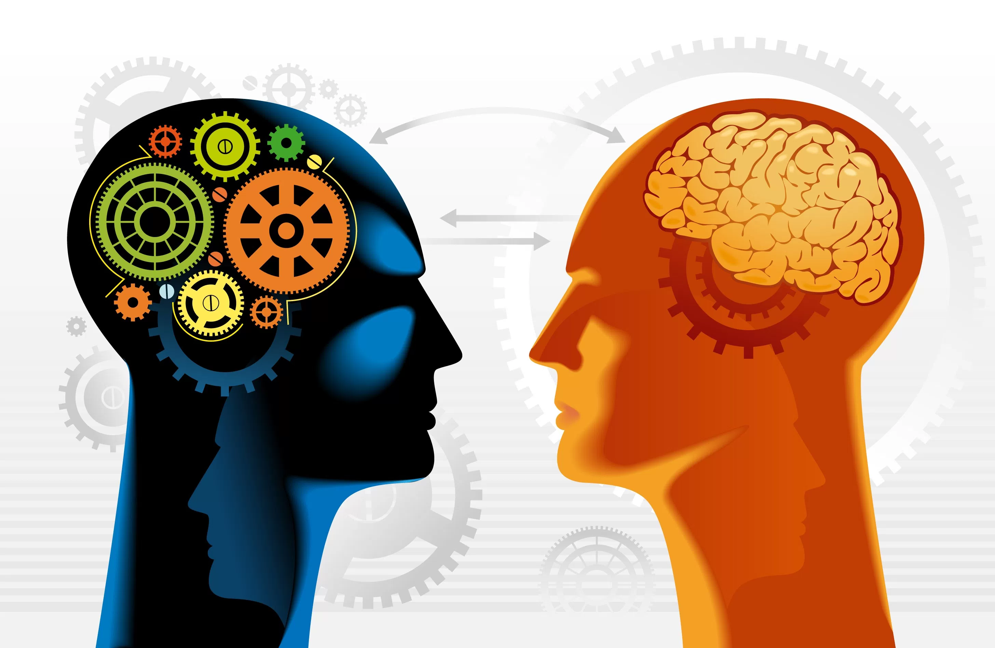
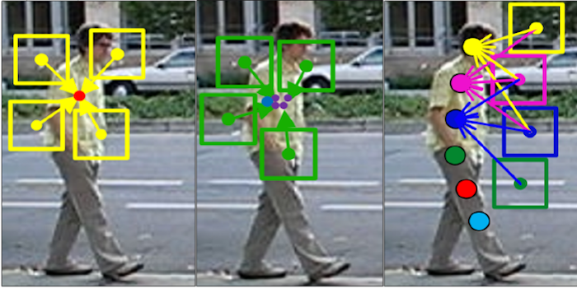
What, why, Application
Workout Pose Detection – Tracking User Movement, classify it corresponding to specific trained workout and determine whether performed pose correct or not.
Why
Flexibility - Indoor or Outdoor Gym
Act as Personal fitness trainer
Wrong Postures during workouts are dangerous – can lead to permanent joint damages
One tenth the cost of what a fitness seeker pays a real-life fitness trainer
Members prefer workout regimens that are fun, customizable and social
Application
Intelligent conversational agent, requires speech recognition, voice recognition and NLP to interact with the exerciser in real time
Computer vision to do workout pose recognition (correct and wrong poses) by deep learning networks
Intelligent conversational agent for pose correction in real time

Slide 4
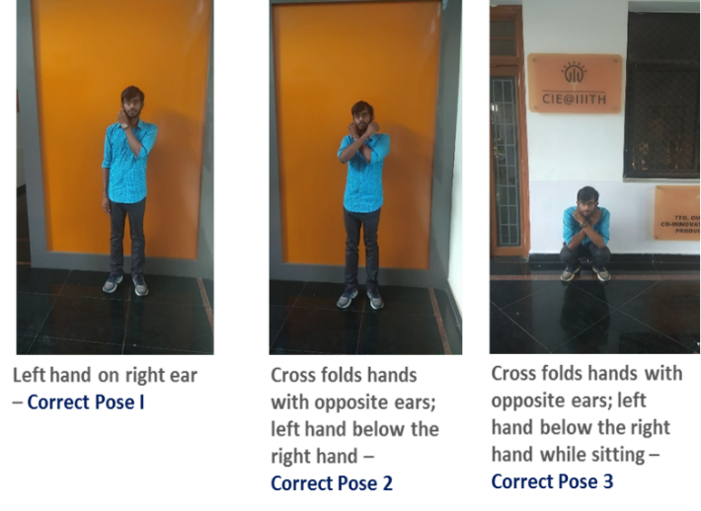
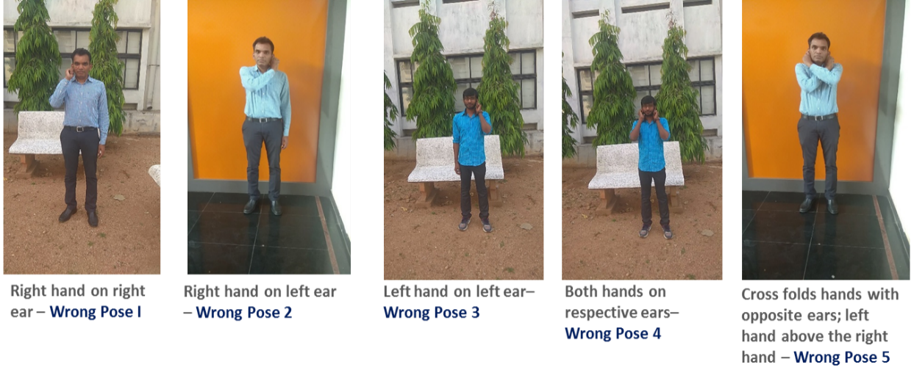
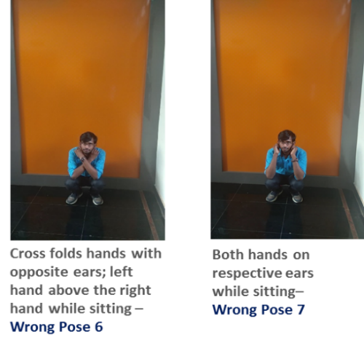
ABOUT THE DATASET
Total 40 videos of brain yoga workout captured containing workout poses performed by different individuals, recorded by mobile phone.
Out of 40 videos, 20 videos contained only accurate poses and were recorded by changing the camera orientations – Front, Right and Left. The length of these initial set of videos were approximately 1 minute each.
Data cycle
Videos
Frames
(200 Frame/minute)
Class Labels (Ten label)
CORRECT POSES
WRONG POSES

Slide 5
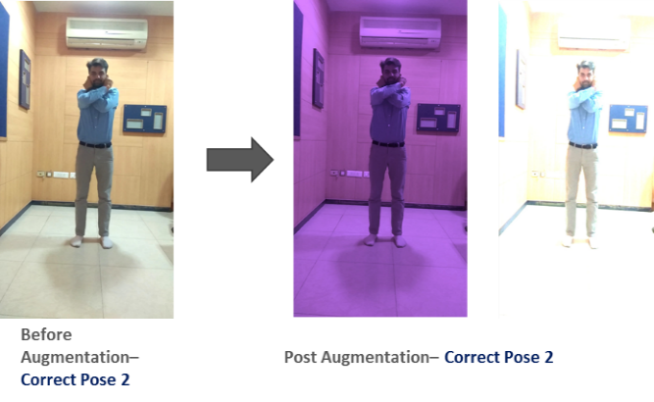





ABOUT THE DATASET - Operations
Image Augmentation
Need because of variation in background
To increase dataset size
Techniques Used – Gaussian blur, Hue and saturation, color, Elastic Transformation
Person extraction from Frame
To minimize background interferences while modelling
Real-time object detection system, prepares a bounding box around the image and predict the object
Open Source Computer Vision Library - an open source computer vision and machine learning software library
Open source framework built on top of Tensor Flow that makes it easy to construct, train and deploy object detection models
All the three techniques, helped us in extracting persons from frames, however Tensor flow API was found to be more robust and scalable for all ten different classes

Slide 6
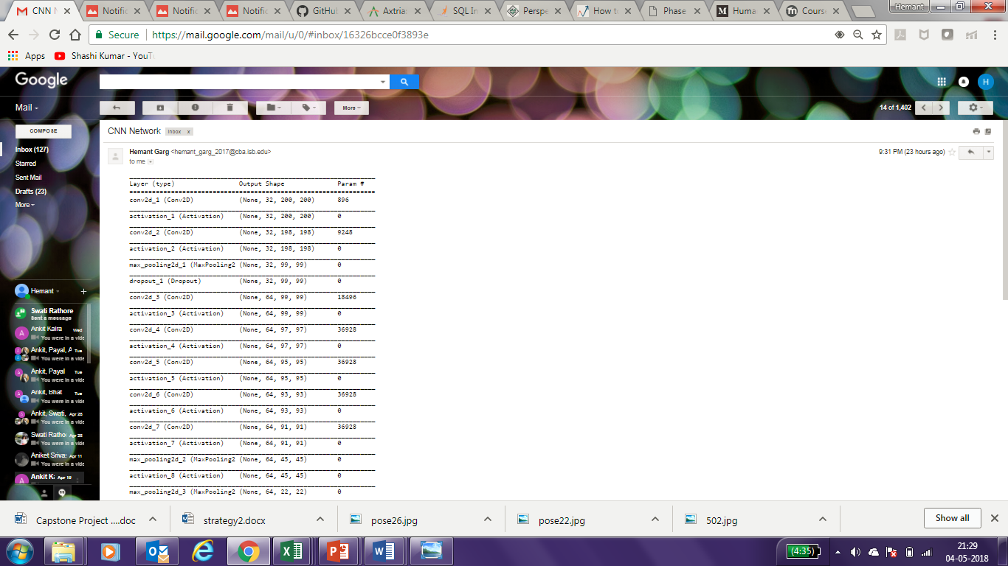
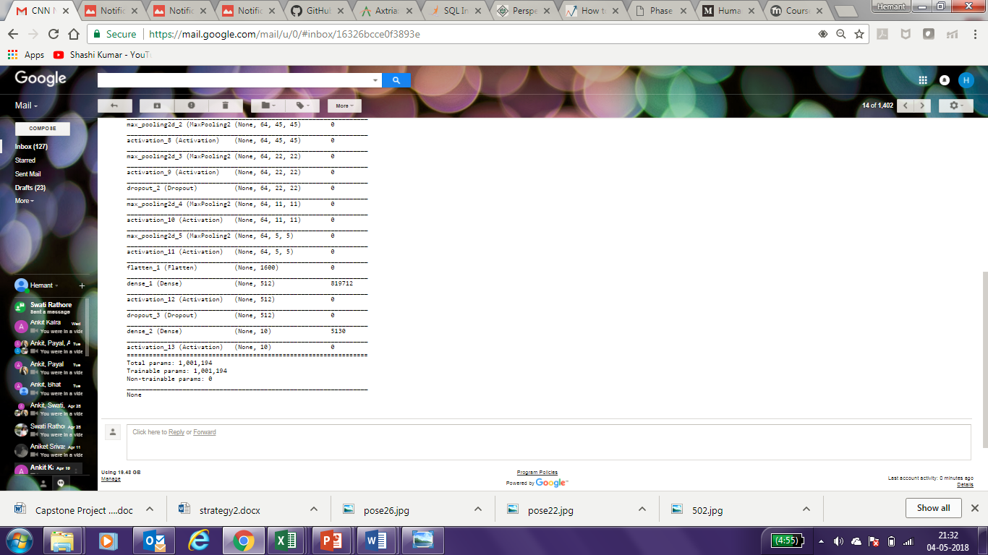
Model training
CNN Model Architecture (7-layers)
We started exploring several approaches for building an accurate and robust model for ten class classification problem
Labelled Image Dataset
Data Partitioning (Train/Validation : 70/30)
Build CNN Model – Different approaches
Evaluate validation set performance
Model Selection
Build CNN Model with 7 convoluted layer & 13 activation layers
Build CNN Model with 10 convoluted layer & 16 activation layers
Build CNN model using VGG-Net pre-trained weights
1st model with different learning rates & batch sizes

Slide 7
MODEL COMPARISON
Evaluating performances of above discussed Architectures that were optimized for different parameters
Attributes
MODEL I
MODEL II
MODEL III
MODEL IV
CNN Layers
7
10
19
7
Activation layers
13
16
-
13
Learning rate
0.0005
0.001
0.001
0.001
Batch Size
32
32
32
64
Pretrained weights
NA
NA
VGG-Net
NA
Steps/epoch
1000
1000
1000
1000
No. of epochs
12
21
21
6
Validation accuracy
80%
60%
60%
91%
Model 4 seems to work best.

Slide 8
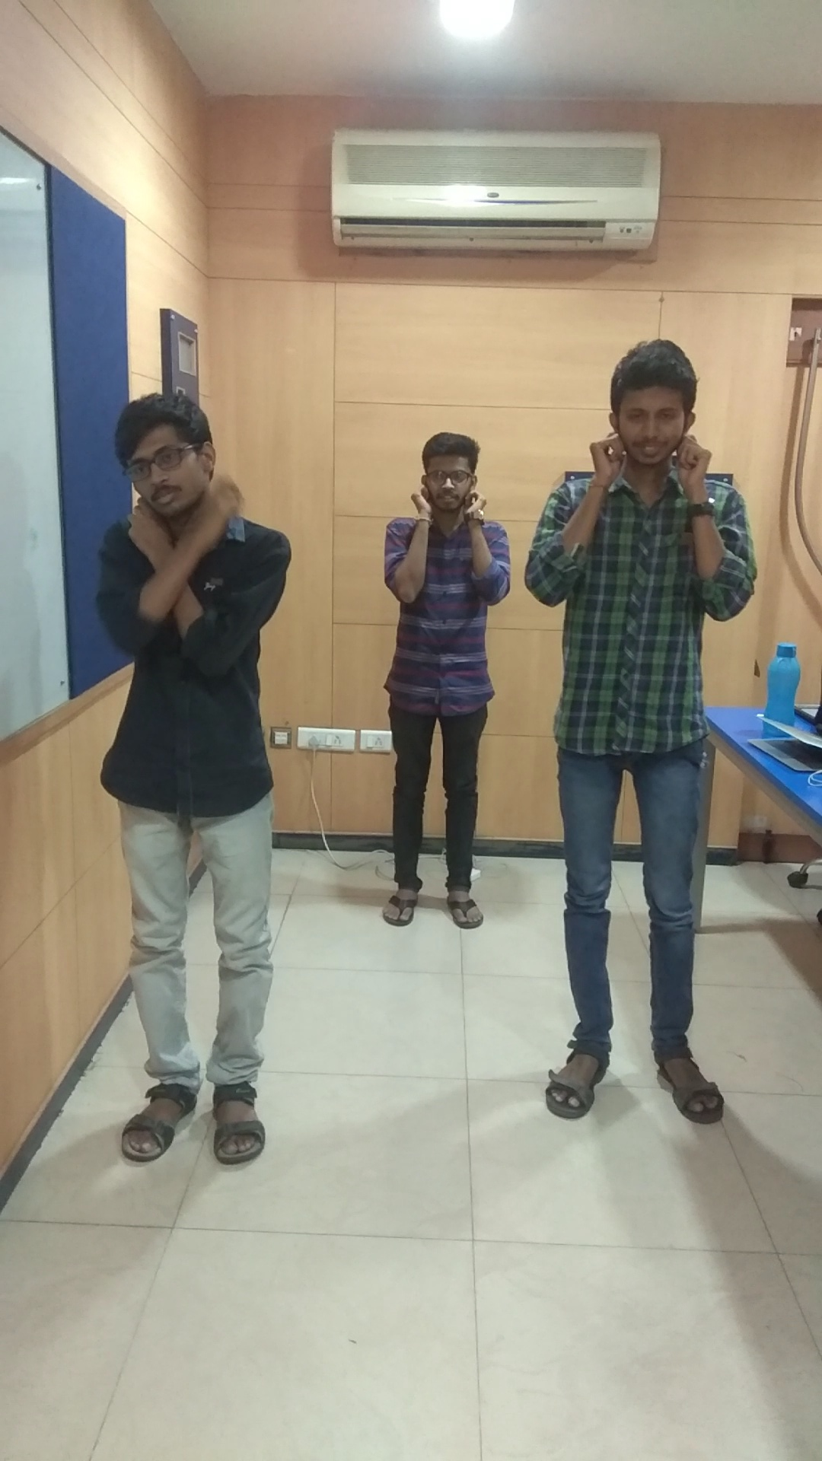
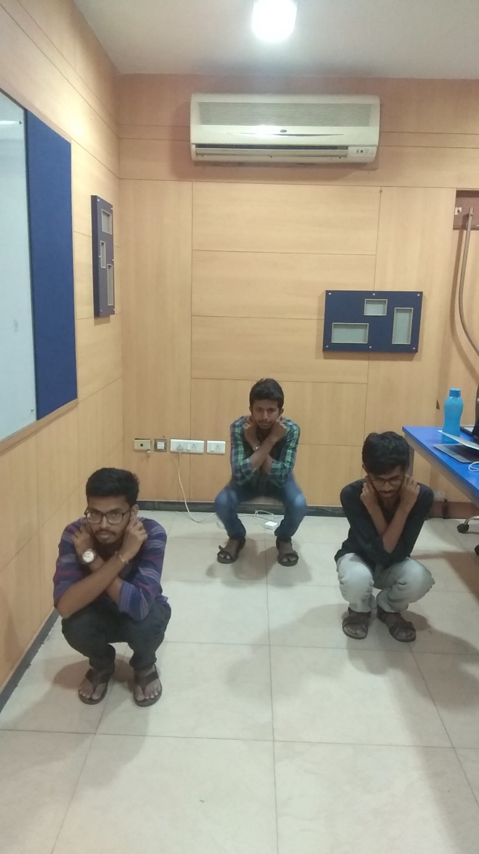




result
Identifying correct pose with Accuracy 90 %
INPUT - TEST VIDEO 1 minute
OUTPUT - FRAMES WiTH PROBABILITY SCORES
5012_0_pose 1_0.5779795
5079_2_pose 2_0.83053553
5101_0_pose 3_0.9778807
5101_1_pose 3_0.99151784
Accuracy of the test 90%

Slide 9
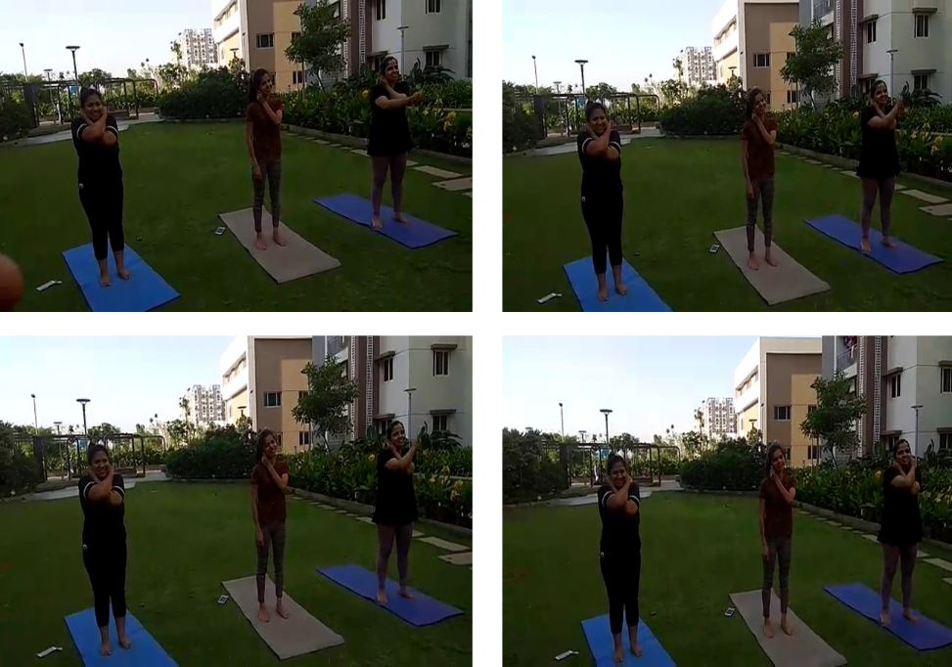
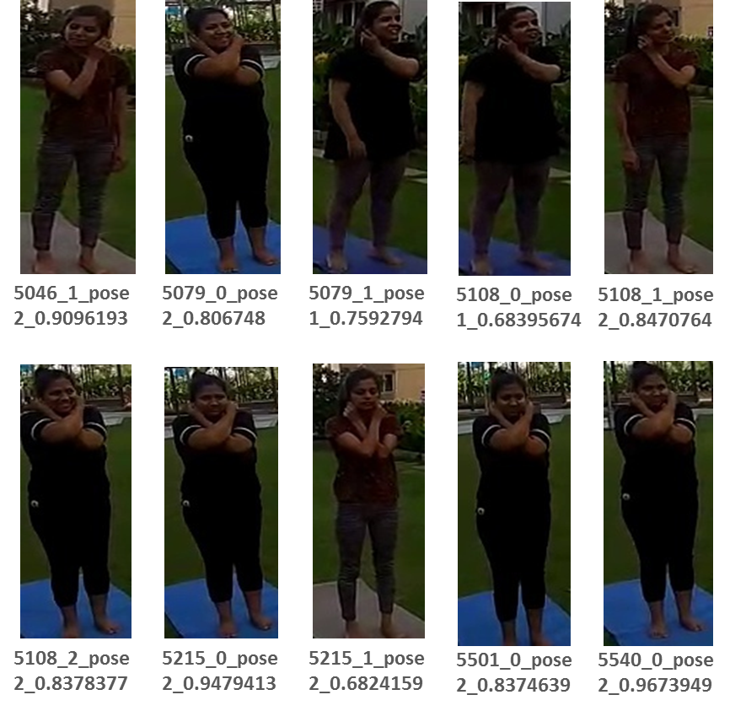
Result contd..
Identifying correct pose with Accuracy 80 %
INPUT - TEST VIDEO 1 minute 17 SEC.
OUTPUT - FRAMES WiTH PROBABILITY SCORES
Accuracy of the test 80%
The low test accuracy was the result of different camera orientations (model not trained on different orientations based on limited dataset).

Slide 10
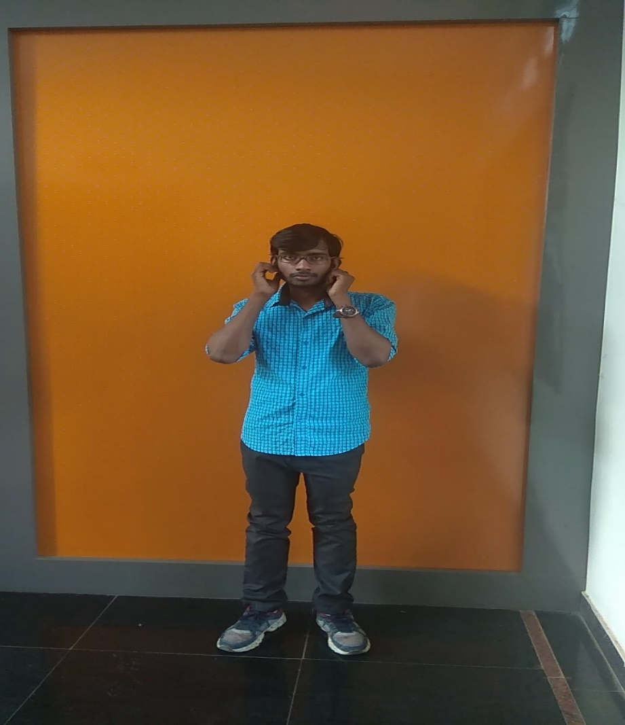
Result contd..
Identifying incorrect pose
5570_0_pose 4_0.7579795

Slide 11
Challenges & Future Scope
Challenge
Model will not perform good if videos or frames are captured at different orientations and if person is too close or far in frames because model is not trained on certain type of distribution of images. So, need more images with different person, different angles and person at different depths.
Data Preparation – Labelling the brain yoga dataset finally into ten class labels was the biggest challenge as the number of wrong poses can be done in different combinations in real-time scenarios.
Future Scope
Leverage Mask R-CNN to avoid person extraction from frame.
For proper cropping of person from images, using TensorFlow object detection API and giving accuracy of more than 95%. This can be further improved by using TensorFlow object detection API for custom object detection with label marked down as person.

